Slide 1

Yamhill County HHS Fraud, Waste and Abuse Policy
YCHHS is committed to the development and implementation of a plan of prevention, detection, monitoring and investigation to reduce fraud and abuse.
We will review and investigate reported allegations of fraud and/or abuse, whether internal or external, to take corrective action for any supported allegations, and to report misconduct to the appropriate parties
The Fraud, Waste & Abuse (FWA) policy encompasses all Divisions of the Department

Slide 2

Introduction
Required under Medicare/Medicaid (CMS) rules
Required as part of Yamhill Community Care (YCC) contract
Requires reporting possible FW&A by HHS staff, other OHP providers, or by OHP members

Slide 3
Purposes of this Session
Provide brief background on the need for prevention of Medicaid FW&A
Orient participants to the YCHHS Fraud, Waste & Abuse policy
Describe what actions you may need to do

Slide 4
What is Fraud?
“Intentional deception or misrepresentation made by a person with the knowledge that the deception could result in some unauthorized benefit to him/herself or some other person.”
A Medicaid provider submits a claim for services or supplies that were not provided.
An employee falsifies client medical records in order to gain reimbursement for services.
A person applying for Medicaid benefits reports their household income as $500/mo when it’s actually $6,000/mo

Slide 5
What is Waste?
Waste is generally understood to encompass the overutilization or inappropriate utilization of services and misuse of resources
Waste typically is not an intentional act

Slide 6
What is Abuse?
“Practices that are inconsistent with sound fiscal, business or medical practices, and result in unnecessary costs to the Medicaid/OHP program, or in reimbursement for services not medically necessary or fail to meet professionally recognized standards of health care. It also includes recipient [member] practices that result in unnecessary costs to the Medicaid program.”
A provider “up codes” reported service (increases the duration or type of service)
orders diagnostics that are not medically necessary.
A provider fails to meet the professionally recognized documentation requirements.

Slide 7

Federal Laws
It is a crime for a person to knowingly engage in actions that are fraud, waste or abuse.
Federal False Claims Act (31 USC 3729-3733)
Penalties and triple damages against anyone who knowingly submits or causes to submit false or fraudulent claims for Medicaid and other federal funds.
Quid tam provisions: A “whistleblower” can file suit in federal court, on behalf of the federal government, against the alleged fraudsters and then share in any money recovered by the government.

Slide 8
Program Fraud Civil Remedies Act (31 USC Chapter 3801-3812) Also referred to as “administrative remedies for false claims and statements”
Anyone who knowingly makes, presents, submits or causes to submit false, fictitious or fraudulent claims, or omits a material fact, for Medicaid and other federal funds is subject to a penalty of up to $5,000 per claim plus up to twice the amount of each submitted claim.
Federal Regulation 42 CFR Subpart A 455.12-455.106 Medicaid Agency Fraud Detection and Investigation program defines the responsibilities of the state
Investigations conducted by US Inspector General; enforcement can start with an administrative law hearing.
Government can recover penalties by lawsuit or by offset against “clean” claims.
Definition of fraud, waste and abuse (42 USC 1320a-7b)

Slide 9

State Laws
It is a crime for a person to knowingly engage in actions that are fraud, waste or abuse.
Oregon laws pertaining to civil or criminal penalties for false claims and statements:
ORS 411.670 to 411.690: Submitting wrongful claim or payment prohibited; liability of person wrongfully receiving payment; amount of recovery
ORS 646.505 to 646.656: Unlawful trade practices
ORS Chapter 162: Crimes related to perjury, false swearing and unsworn falsification

Slide 10
ORS Chapter 164: Crimes related to theft
ORS Chapter 165: Crimes involving fraud or deception, including but not limited to falsification of business records (ORS 165.080) and false claims for health care payment (ORS 165.690 to 165.698)
ORS 166.715 to 166.735: Racketeering – civil or criminal
ORS 659A.200 to 659A.224 and ORS 659A.230 to 659A.233: Whistleblowing
OAR 410-120-1395 to 410-120-1510: DMAP program integrity, sanctions, fraud and abuse
Common law claims founded in fraud, including Fraud, Money Paid by Mistake and Money Paid by False Pretenses
Participating providers may be subject to other fraud and abuse laws not identified above.

Slide 11

Whistleblower Protections
Individuals of HHS who come forward with evidence of fraud, waste and abuse involving Medicaid Funds have legal protections through the Federal False Claims Act (31 USC 3729-3733 and Oregon Whistleblowers Law (ORS 659A.200-224 & ORS 659A.230-233).

Slide 12
HHS FW&A Policy
Required Elements of
FW&A Prevention and Detection:
Provider credentialing verification
Staff conflict of interest disclosure requirements
Staff education about FW&A policy
OHP Member Complaints and Appeals process
Auditing of charts and billing/claims data
Repayment, data correction procedures
Controls on staff access to resources
Disciplinary guidelines for staff determined to have committed fraud, waste or abuse

Slide 13
HHS FW&A Policy
What do we need to do for suspected FW&A?
Employees, clients or others will be asked to complete a FW&A reporting form.
There are several possible follow up actions depending on the investigation:
Investigate and respond to suspected or verified FW&A reported to YCC
Refer suspected or verified FW&A to Medicaid Fraud Control Unit (MFCU), notify DHS-AMHD
Contact your division manager or compliance officer if you have questions.

Slide 14
HHS FW&A Policy A Few More Important Points
FW&A allegations can be reported anonymously.
HHS cannot require employee to obtain prior approval before reporting FW&A
Employees are protected from retaliation under federal and state “whistleblower” regulations when reporting FW&A.
State and federal authorities are not limited in their authority to purse legal redress for FW&A to the fullest extent.

Slide 15
3 Reporting Options for YCC Members
Option 1: Use HHS procedure for FW&A reporting
Option 2: Use YCC FW&A reporting platform, EthicsPoint
Toll-free phone number 1-844-989-2845
Or go to http://yamhillcco.ethicspoint.com and click on the “Make a Report” tab
Option 3: Report to the Medicaid Fraud Control Unit
1-888-372-8301

Slide 16
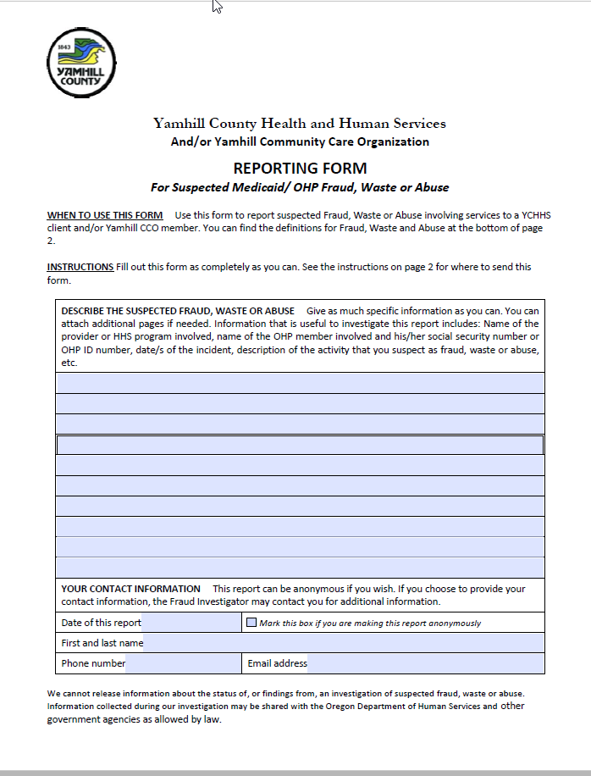
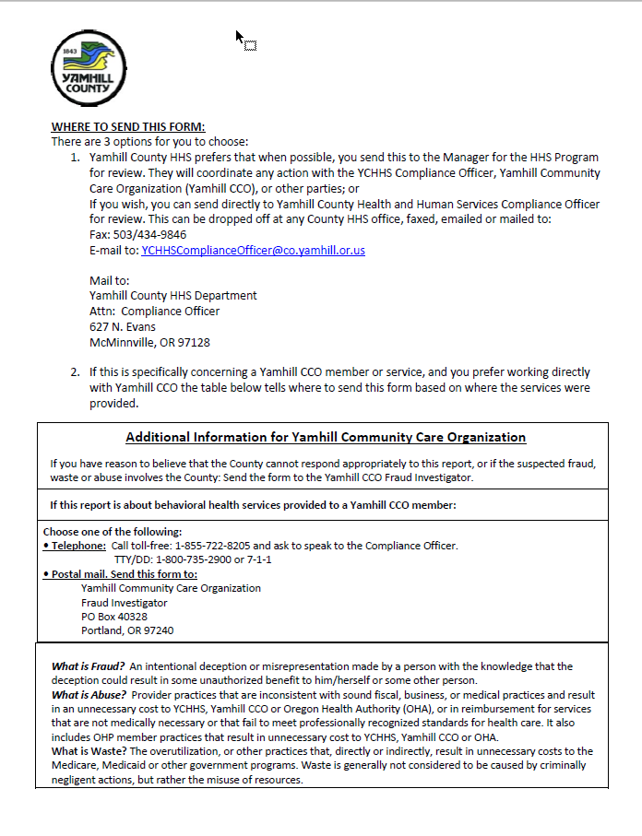
HHS Reporting Form (Available on HHS intranet: Health & Human Services/Forms) Found on the intranet here: http://intranet/depts/hhs/documents/Fraud%20Waste%20Abuse%20Reporting%20Form%20Fillable.pdf

Slide 17
Yamhill County HHS
HHS Fraud and Abuse Committee:
Developmental Disabilities Manager
Quality Improvement Manager
Public Health Manager
Behavioral Health Director
Health and Human Services Director
IT Manager
Updated 12/15/2021

